Slide 1

Lecture 7
Math Foundations Team

Slide 2
Introduction
In this lecture we will discuss back propagation and automatic differentiation.

Slide 3
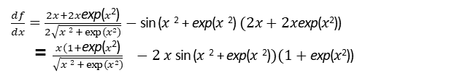
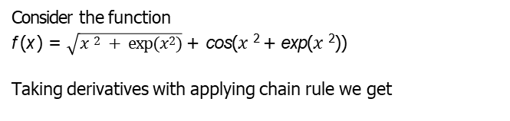
Backpropagation and Automatic Differentiation
Consider the function
f (x ) = $\sqrt{x 2 + exp⁡(x 2)}$ + cos($x$² + exp($x$²))
Taking derivatives with applying chain rule we get
$\frac{df}{dx}=\frac{2x+2x\text{exp}\text{(}x\text{2}\text{)}}{2\sqrt{x 2 + exp⁡(x 2)}}$ $−$sin ($x$² + exp($x$²) $(2x+2x\text{exp}\text{(}x\text{2}\text{))}$
= $\frac{x(1+\text{exp}\text{(}x\text{2}\text{)}}{\sqrt{x 2 + exp⁡(x 2)}} −2$ $x$ sin ($x$² + exp($x$²)$)(1+\text{exp}\text{(}x\text{2}\text{))}$

Slide 4
Motivation
The implementation of the gradient could be significantly more expensive than computing the function, which imposes unnecessary overhead where we get such lengthy expressions.
We need an efficient way to compute the gradient of an error function with respect to the parameters of the model.
For training deep neural network models, the backpropagation algorithm is one such method.

Slide 5
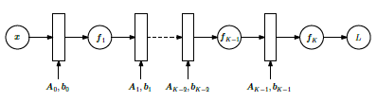
Backpropagation and Automatic Differentiation
In neural networks with multiple layers
fi (xi −1) = σ(Ai −1xi −1 + bi −1)
where x_{i −1} is the output of layer i − 1 and σ is an activation function.

Slide 6
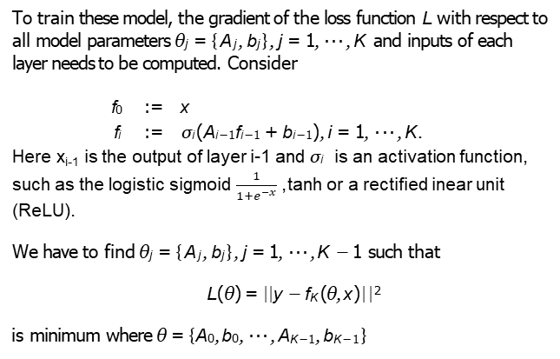
Backpropagation
To train these model, the gradient of the loss function L with respect to all model parameters θ_{j} = {A_{j}, b_{j} }, j = 1, · · · , K and inputs of each layer needs to be computed. Consider
f₀ := x
f_{i} := σ_{i} (A_{i −1}f_{i −1} + b_{i −1}), i = 1, · · · , K.
Here x_{i-1} is the output of layer i-1 and σ_{i} is an activation function, such as the logistic sigmoid $\frac{1}{1+e^{−x}}$ ,tanh or a rectified inear unit (ReLU).
We have to find θ_{j} = {A_{j}, b_{j} }, j = 1, · · · , K − 1 such that
L(θ) = ||y − f_{K} (θ, x )||²
is minimum where θ = {A₀, b₀, · · · , A_{K −1}, b_{K −1}}

Slide 7
Backpropagation
Using the chain rule, we get
∂L ^{∂θ}K −1 | = | ∂L ∂f_{K} ∂f_{K} ∂θ_{K −1}
∂L ^{∂θ}K −2 | = | ∂L ∂f_{K} ∂f_{K −1} ^{∂f}K ^{∂f}K −1 ^{∂θ}K −2
∂L ^{∂θ}K −3 | = | ∂L ∂f_{K} ∂f_{K −1} ∂f_{K −2} ^{∂f}K ^{∂f}K −1 ^{∂f}K −2 ^{∂θ}K −3
∂L ∂θ_{i} | = | ∂L ∂f_{K} ∂f_{i+2} ∂f_{i+1} ^{∂f}K ^{f∂f}K −1 ^{· · · ∂f}i +1 ^{∂θ}i

Slide 8
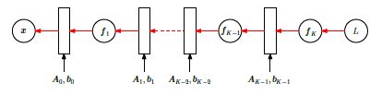
Backpropagation
If the partial derivatives ^{∂L} are computed, then the computation
^{∂θ}i +1
can be reused to compute ^{∂L} .
∂θ_{i}

Slide 9
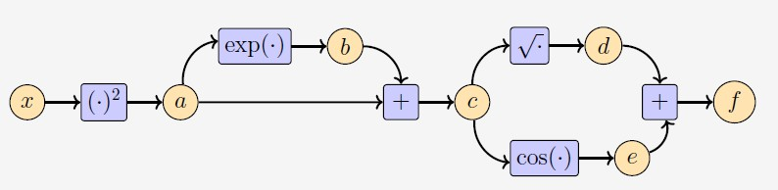
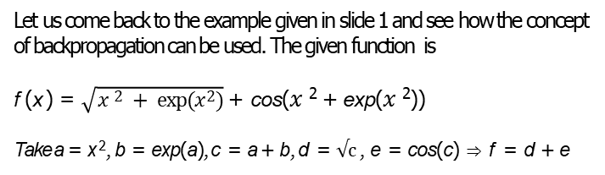
Example
Let us come back to the example given in slide 1 and see how the concept of backpropagation can be used. The given function is
f (x ) = $\sqrt{x 2 + exp⁡(x 2)}$ + cos($x$² + exp($x$²))
Take a = x ², b = exp(a), c = a + b, d = √c , e = cos(c) ⇒ f = d + e

Slide 10
Example
∂a
= 2x
⇒ ∂x
∂b ∂a | = | exp(a)
∂c ∂a | = | ∂c 1 = ∂b
∂d ∂c | = | 1/√c
∂e ∂c | = | −sin(c)
∂f ∂d | = | ∂f 1 = ∂e

Slide 11
Example
Thus, we have
∂f ∂c | = | ∂f ∂d ∂f ∂e + ∂d ∂c ∂e ∂c
∂f ∂b | = | ∂f ∂c ∂c ∂b
∂f ∂a | = | ∂f ∂b ∂f ∂c + ∂b ∂a ∂c ∂a
∂f ∂x | = | ∂f ∂a ∂a ∂x

Slide 12
Example
Substituting the results, we get
∂f
∂c
∂f
∂b
∂f
∂a
∂f
∂x
1
= 1.( _{2√c} + 1).(−sin(c))
∂f
∂c
∂f
∂b
∂f
∂a
=
.1
∂f
=
exp(a) + .1
∂c
=
2x
Thus, the computation for calculating the derivative is of similar complexity as the computation of the function itself.

Slide 13
Formalization of Automatic Differentiation
Let x₁, · · · , x_{d} : input variables.
x_{d +1}, · · · , x_{D−1} : intermediate variables.
x_{D} : output variable, then we have,
^{x}i ^{= g}i ^{(x}Pa(x_{i} )⁾
Note that g_{i} s are elementary functions and are also called as forward propagation function and x_{Pa(xi )} is the set of parent nodes of variable x_{i} in the graph.

Slide 14
Formalization of Automatic Differentiation
Now, $f=x_{D} implies \frac{∂f}{∂x_{D}}=1.$
For other variables, using chain rule, we get
∂f
=
∂x_{i}
∂f ∂x_{j =}
∂x_{j} ∂x_{i}
∂f ∂g_{i}
∂x_{j} ∂x_{i}
Σ Σ
x_{j} :x_{i} ∈Pa(x_{j} ) x_{j} :x_{i} ∈Pa(x_{j} )
The last equation is the back propagation of the gradient through the computation graph. For neural network training, we back propagate the error of the prediction with respect to the label.

Slide 15
Linearization of a function
The gradient f of a function f is often used for a locally linear approximation of f around x₀:
f(x) ≈ f(x₀) + ∇f(x₀) (x – x₀)
Here ∇f(x₀) is the gradient of f with respect to x, evaluated at x₀.
Here the original function is approximated by a straight line.
This approximation is locally accurate, but the farther we move away from x₀ the worse the approximation gets.
Note that they are first two terms of the Taylor series of f(x).

Slide 16
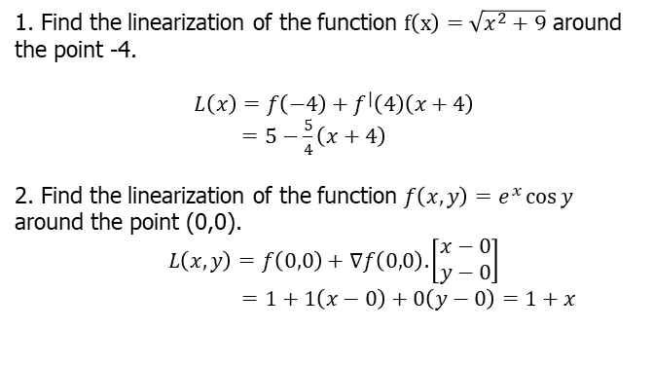
Examples
1. Find the linearization of the function $f\left(x\right)=\sqrt{x^{2}+9}$ around the point -4.
$$L\left(x\right)=f\left(−4\right)+f^{|}\left(4\right)\left(x+4\right)$$
$=5−\frac{5}{4}\left(x+4\right)$
2. Find the linearization of the function $f\left(x,y\right)=e^{x}\cos{y }$
around the point (0,0).
$$L\left(x,y\right)=f\left(0,0\right)+∇f\left(0,0\right).\left[\begin{matrix}x−0 \\ y−0\end{matrix}\right]$$
$=1+1\left(x−0\right)+0\left(y−0\right)=1+x$

Slide 17
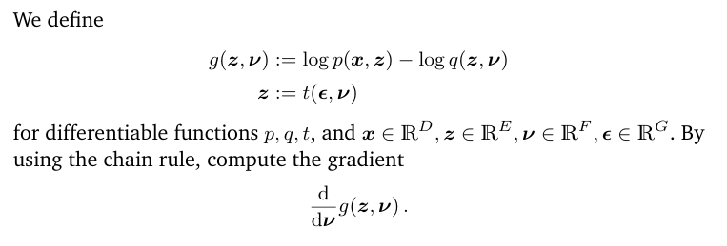
Problem1

Slide 18
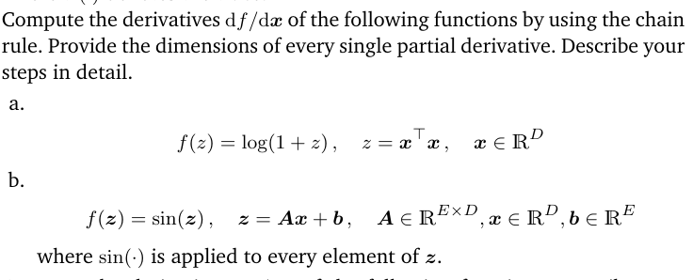
Problem2

